Slide 1
Digital logic design
Lecture 06

Slide 2

Constructing a Truth Table for a Logic Circuit
Once the Boolean expression for a given logic circuit has been determined, a truth table that shows the output for all possible values of the input variables can be developed. The procedure requires that you evaluate the Boolean expression for all possible combinations of values for the input variables. In the case of the circuit in Fig., there are four input variables (A, B, C, and D) and therefore sixteen ($2^{4}=16$) combinations of values are possible

Slide 3
Putting the Results in Truth Table format
The first step is to list the sixteen input variable combinations of 1s and 0s in a binary sequence as shown in Table. Next, place a 1 in the output column for each combination of input variables that was determined in the evaluation. Finally, place a 0 in the output column for all other combinations of input variables. These results are shown in the truth table in Table.

Slide 4
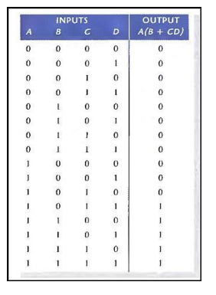
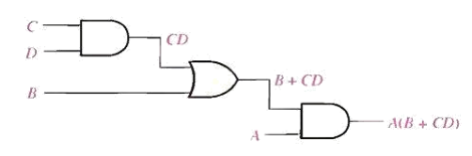

Slide 5
Determine the simplified Boolean expression, truthtable and logic diagram

Slide 6
Integrated Circuits “IC”
- It’s a small silicon semiconductor, called a chip, containing the electronic components for the digital gates. The gates are interconnected inside the chip to form the required circuit.
Levels of Integration
- Small-scale Integration (SSI): contains several independent gates in a single package. The number of gates is usually fewer than 10.
- Medium-scale Integration (MSI): have a complexity between 10 and 100 gates in a single package. They perform specific digital operations such as decoders, adders, and multiplexers.
- Large-scale Integration (LSI): contains between 100 and 1000s gates in a single package. The number of gates is usually fewer than 10. They include processors, memory chips, and programmable logic devices.
- Very Large-scale Integration (VLSI): contains thousands of gates in a single package. Examples are large memory arrays and complex microcomputer chips.

Slide 7
Fan-in
Fan-in is a term that defines the maximum number of digital inputs that a single logic gate can accept. Most transistor- transistor logic ( TTL ) gates have one or two inputs, although some have more than two. A typical logic gate has a fan- in of 1 or 2.
Fan-out
Fan-out is a term that defines the maximum number of digital inputs that the output of a single logic gate can feed. Most transistor-transistor logic ( TTL ) gates can feed up to 10 other digital gates or devices. Thus, a typical TTL gate has a fan-out of 10.

